Slide 1
Project Presentation of Co-Op - II
On
Deepfake Detection Using CNN and Capsule Networks:
A Comparative Analysis and Performance Evaluation
By
Liza(2210991853)
Supervised By Mr. Ajay
Department of Computer Science and Engineering, Chitkara University, Punjab

Slide 2
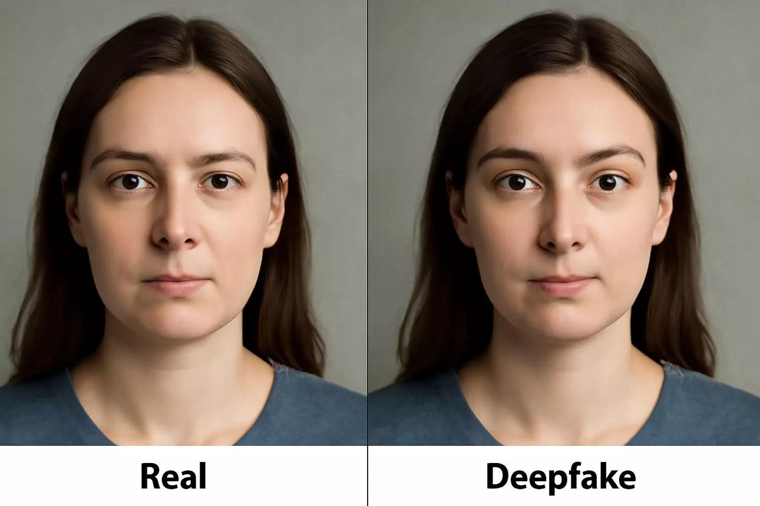
INTRODUCTION
Deepfake technology has rapidly evolved with advancements in deep learning, making it increasingly difficult to distinguish between real and manipulated media. While deepfakes have useful applications in entertainment, they pose serious risks including misinformation, identity theft, and privacy violations.
CNNs are widely used for detecting visual inconsistencies but fail to preserve spatial relationships between facial features.
Capsule Networks are introduced to overcome this limitation by maintaining spatial hierarchies and part-whole relationships.
Objective: To implement and evaluate CNN and Capsule Network-based deepfake detection using accuracy, precision, recall, and F1-score.

Slide 3
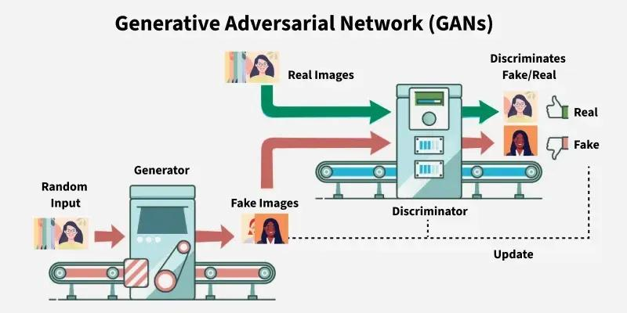
BACKGROUND
Deepfake generation has advanced rapidly using complex neural networks (GANs and autoencoders) to manipulate identity, facial expression, and speech. While useful in entertainment and media, deepfakes pose critical risks. CNNs dominate detection but struggle with spatial relationships. Capsule Networks offer a promising alternative by preserving spatial hierarchies.
Key Architectures: CNN (ResNet, Xception, EfficientNet), Capsule Networks
Evolution: Handcrafted features → Deep Learning → Hybrid models
Research Gap: CNNs lose spatial info; no comprehensive hybrid evaluation

Slide 4
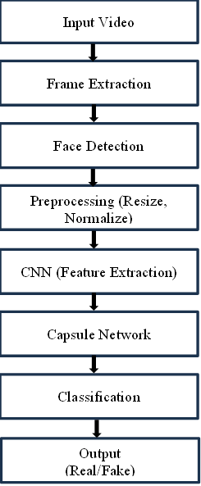
METHODS
System Pipeline:
Input video frames are extracted and face detection is applied to isolate
facial regions.
Faces are resized and normalized for consistency across the dataset.
CNN model extracts hierarchical features: textures, edges,
and visual artifacts.
Classification:
Capsule Network preserves spatial relationships between facial components.
Fully connected layer classifies output as Real or Fake.
Datasets: FaceForensics++ and DFDC (80:20 train/test split).
Metrics: Accuracy, Precision, Recall, F1-Score.

Slide 5
RESULTS
CNN Model Results
Effectively captures visual artifacts and texture irregularities.
Pooling operations cause loss of spatial information between facial features.
Accuracy: 89.1% | Precision: 88.3% | Recall: 87.9% | F1: 88.1%
Best on: FaceForensics++ dataset.
Hybrid CNN–Capsule Model
Accuracy: 92.4% | Precision: 91.2% | Recall: 90.8% | F1: 91.0%
Outperforms standalone CNN and Capsule models across both datasets.
Stable convergence with minimal overfitting across training epochs.
Strong generalization to unseen manipulation types.

Slide 6
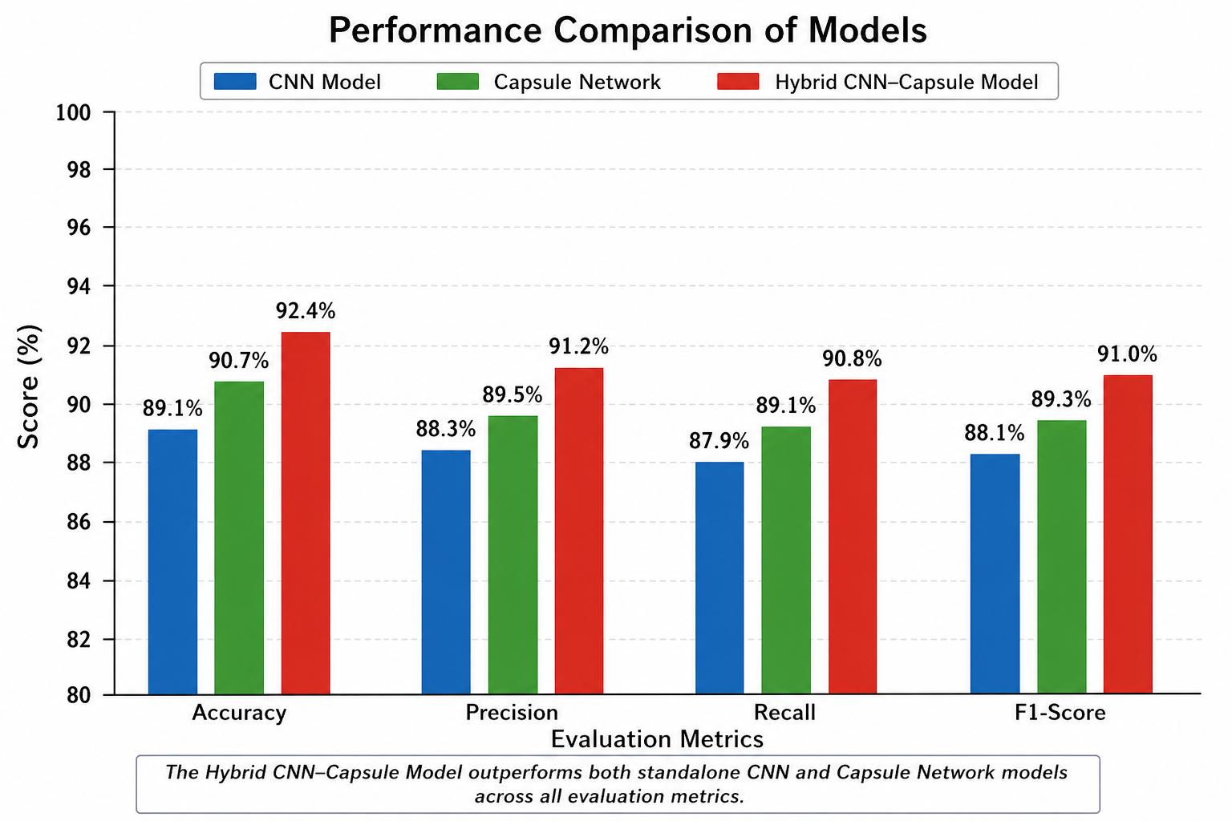
RESULTS
Capsule Network Results
Preserves spatial hierarchies and part-whole relationships between facial features.
Better detection of subtle structural inconsistencies missed by CNNs.
Accuracy: 90.7% | Precision: 89.5% | Recall: 89.1% | F1: 89.3%

Slide 7
CHALLENGES VS FUTURE DIRECTIONS
Key Challenges
Future Directions
Poor generalization to unseen deepfake types
Limited dataset diversity vs real-world conditions
High computational cost of hybrid models
CNNs lose spatial info; CapsNets not fully optimized
Continuously evolving deepfake generation techniques
Lack of model interpretability and transparency
Efficient, scalable real-time detection models
Larger, more diverse training datasets
Multimodal detection: visual + audio + temporal
Lightweight models for edge and mobile deployment
Robustness against adversarial attacks
Improved model interpretability and explainability

Slide 8
DISCUSSION
The hybrid CNN–Capsule model outperforms standalone architectures across both FaceForensics++ and DFDC datasets, achieving 92.4% accuracy with strong precision, recall, and F1-score.
CNNs effectively extract low-level visual artifacts, but lose spatial relationships. Capsule Networks address this by preserving part-whole and hierarchical structures in facial regions.
The hybrid approach combines the strengths of both models, improving robustness and generalization, though it introduces additional computational complexity requiring further optimization.
“The proposed CNN–Capsule hybrid model provides reliable and efficient deepfake detection, demonstrating the importance of combining feature extraction with spatial relationship modeling.”

Slide 9
CONCLUSION
Hybrid CNN–Capsule model achieves 92.4% accuracy on benchmark datasets
Outperforms standalone CNN and Capsule Network models
Challenges remain: computational cost, generalization, evolving deepfakes
Future: multimodal detection, edge deployment, adversarial robustness
9

Slide 10
Thank You
10

